Slide 1

Streams Part 1 - pipelines
Part 1 – existing streams, pipeline, implementing streams

Slide 2
Streams (obsah)
Načo sú nám streamy a čo sú to streamy
Čo to znamená programovať streamovo
Aké streamy máme v node.js
tu bude taky prelet cez zakladne node modules a ich streamove pouzivanie
Ako fungujú streamy v node.js
Backpresure, buffering
Ako používať/nepoužívať streamy
Čitanie
Zápis
Tranformácie
Streams API vs. PIPE
a implementácie vlastných Streamov

Slide 3
Streams in JavaScript
Streams API in Browsers - https://streams.spec.whatwg.org
Node.js Streams
https://nodejs.org/api/stream.html
https://github.com/substack/stream-handbook

Slide 4
node.js streams

Slide 5
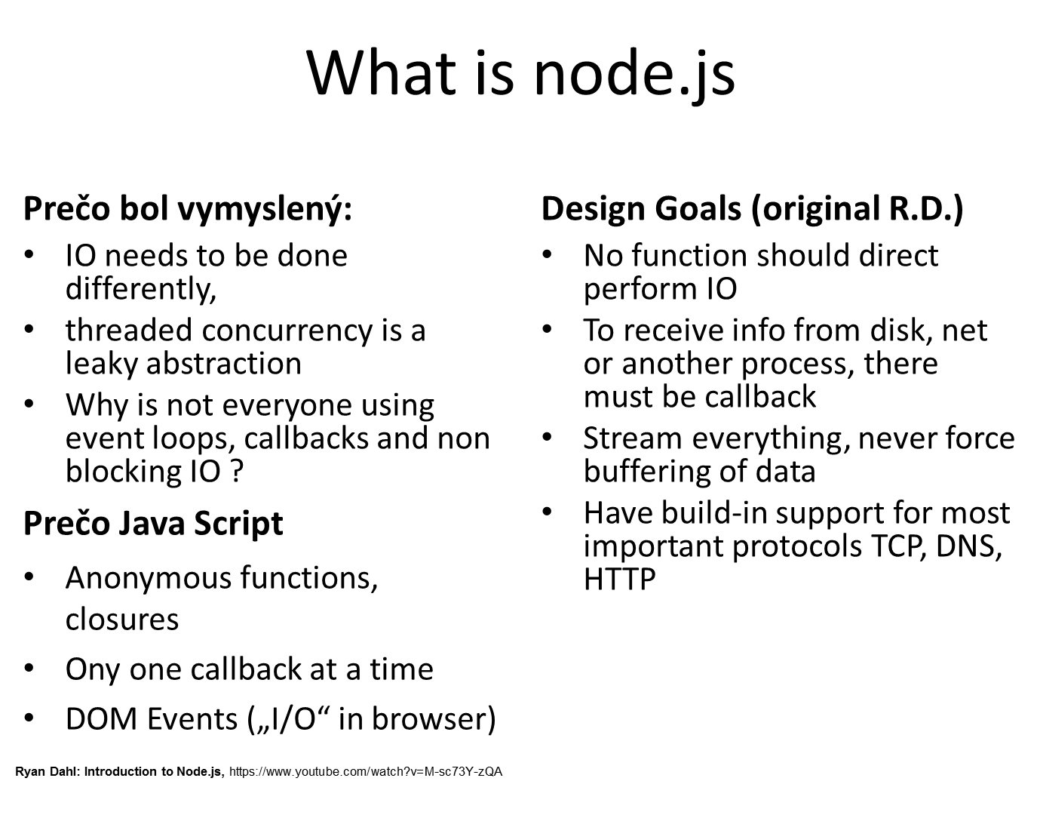
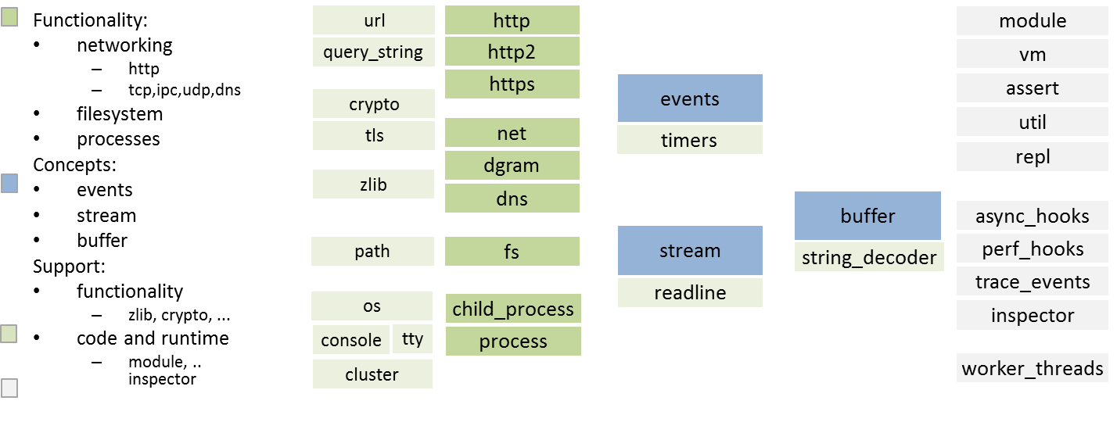
RECAP: Čo je to node.js ?
node.js =
events
streams
buffers

Slide 6
what are streams

Slide 7
What Are Streams
Streams are collections of data (like []) but are not of known and/or finite size
They do not have to fit in memory
powerful when working with large amounts of data,
or data that’s coming from an external source one chunk at a time
power of composability in our code. Just like we can compose powerful linux commands

Slide 8
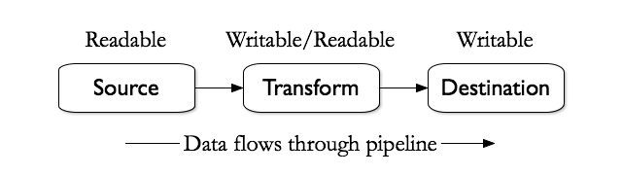
What Are Streams
Streams come from the earliest days of unix and have proven themselves over the decades as a dependable way to compose large systems out of small components that do one thing well.
Unix (shell) a|b|c
node.js a.pipe(b).pipe(c)
FP pipe const abc=pipe(a,b,c)
Notes:
https://github.com/substack/stream-handbook

Slide 9
traditional vs. streaming code

Slide 10
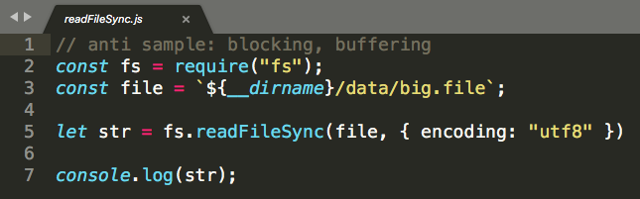
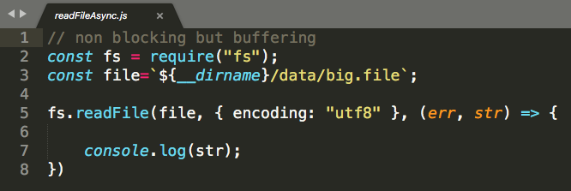
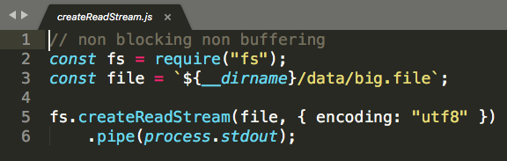
read-write , compare styles
File Size: 33 096 (kB)
old „Java Style“ coding
Memory (kB)
sync: 118 156
„JS Callback Style“
Memory (kB)
async: 150 972
„JS Pipeline Style“
Memory (kB)
pipe: 35 748
/samples/01-read-file
Notes:
porovnajme si tri styly kodovania toho isteho, je to viac menej RECAP z paradigm a styly prednasky, a pozrime sa kolko memory ten program spotrebuje v zavislosti na velkosti suboru.
Ciselka sa mozu lisit od verzie nodu a verzie OS.
Priklady su v 2019-javascript/

Slide 11
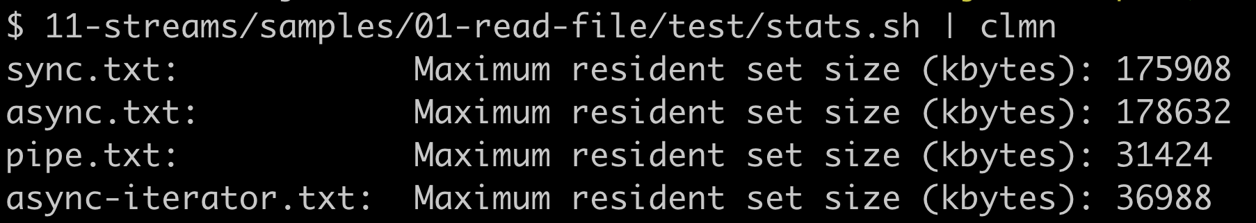
read-write , compare memory

Slide 12
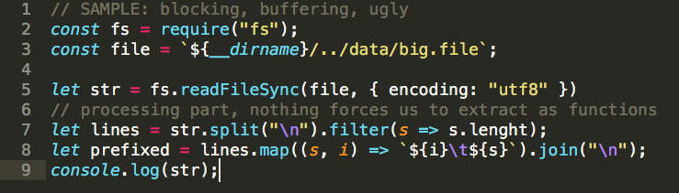
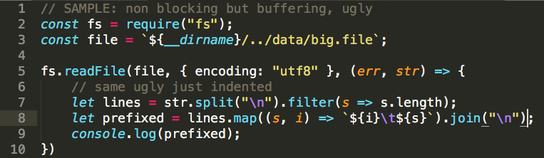
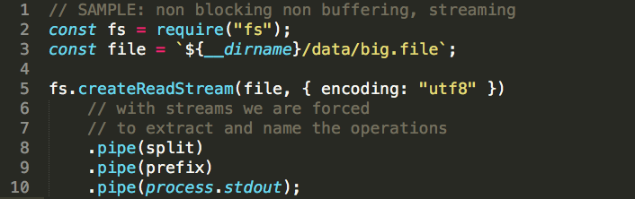
read – transform-write , compare styles
ugly,
variables,
imperative,
pomiesany split a prefix
nic nas nenuti to napisat krajsie
to isté len ešte "odtabované"
kvôli callbacku
tuná by som to už
asi inline nenapísal,
nezmestil by som sa a
trocha ma to núti extrahovať
pomenovávať a rozdelovať
2019-javascript/10-prednaska/samples/01-read-lines/pipeImpl.js
Notes:
Ak zkomplikujeme priklad z predosleho slajdu aj o nejaky processing (napriklad slit na riadky). Porovnavajme styl a citatelnost kodu.

Slide 13
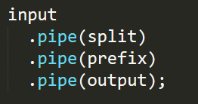

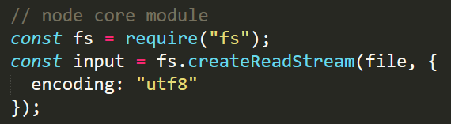
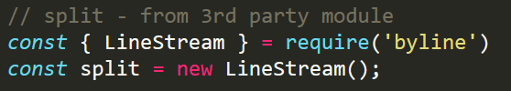
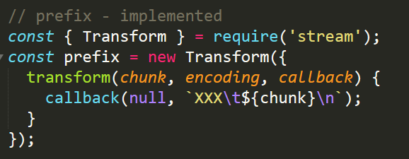
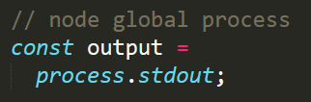
pipeline – coding with streams
input
pipe
pipeline kódovanie: spájanie streamov z
node,
3rd party a
vlastných implementácií
split
pipe
prefix
pipe
output
2019-javascript/10-prednaska/samples/01-read-lines/pipeImpl.js

Slide 14
types of node streams and their usage

Slide 15
Types of Streams
Readable – môžeme z nich čítať
Writable – môžeme do nich zapisovať
Duplex – aj čítať aj zapisovať
Transform – špeciálny prípad Duplexu, transformujúci vstupy na výstupy

Slide 16
Types of Streams
Binary – Buffers
video, voice, sensors data, ... (texts)
Text – strings
text processing
ale stretneme aj Buffer lebo encodings
Objects - Objects, Arrays
Spracovanie objektov/štruktúr
Implementácia BL pomocou stream abstrakcie

Slide 17
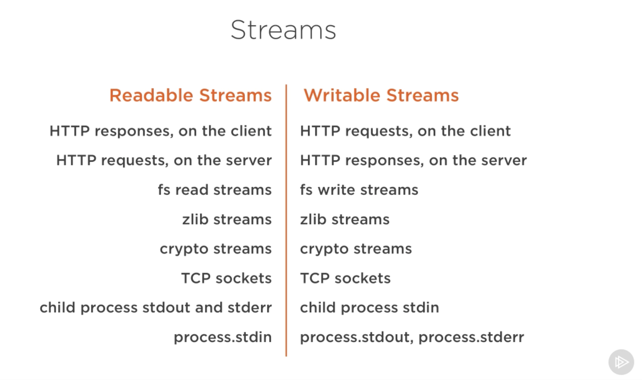
existing node.js streams
Notes:
https://cdn-images-1.medium.com/max/1600/1*lhOvZiDrVbzF8_l8QX3ACw.pnghttps://cdn-images-1.medium.com/max/1600/1*lhOvZiDrVbzF8_l8QX3ACw.png

Slide 18
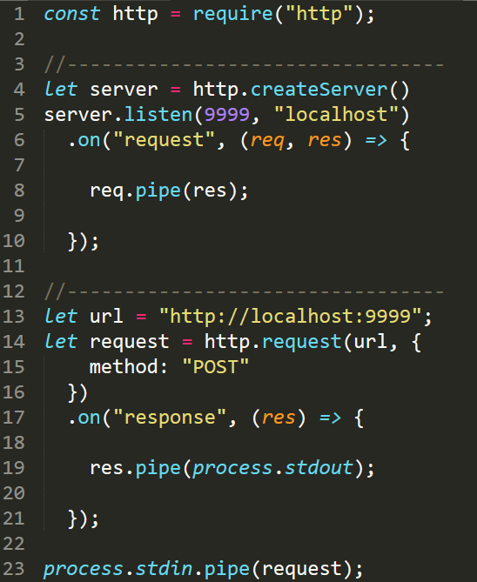
http streams
on server
request is readable (8)
response is writable (8)
on client
request is writable (23)
response is readable (19)
https://nodejs.org/api/http.html
./samples/02-node-js-streams

Slide 19
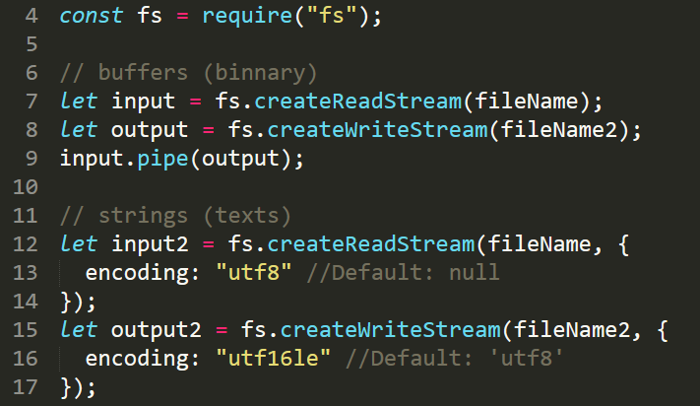
fs streams – NA ZADANIE
read files as streams
by default works with buffers
if you need strings emitted specify encoding
write files as streams
if writing strings, by default utf8 is used
./samples/02-node-js-streams/fs-streams.js
https://nodejs.org/api/fs.html

Slide 20

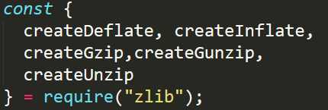
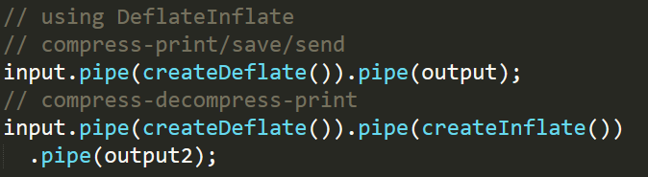
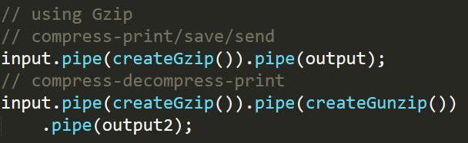
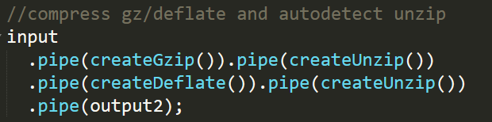
zlib streams
Compress data
deflate
gzip
Decompress data
inflate
gunzip
uzip - autodetect
https://nodejs.org/api/zlib.html
/samples/node-js-streams/zlib-*.js

Slide 21
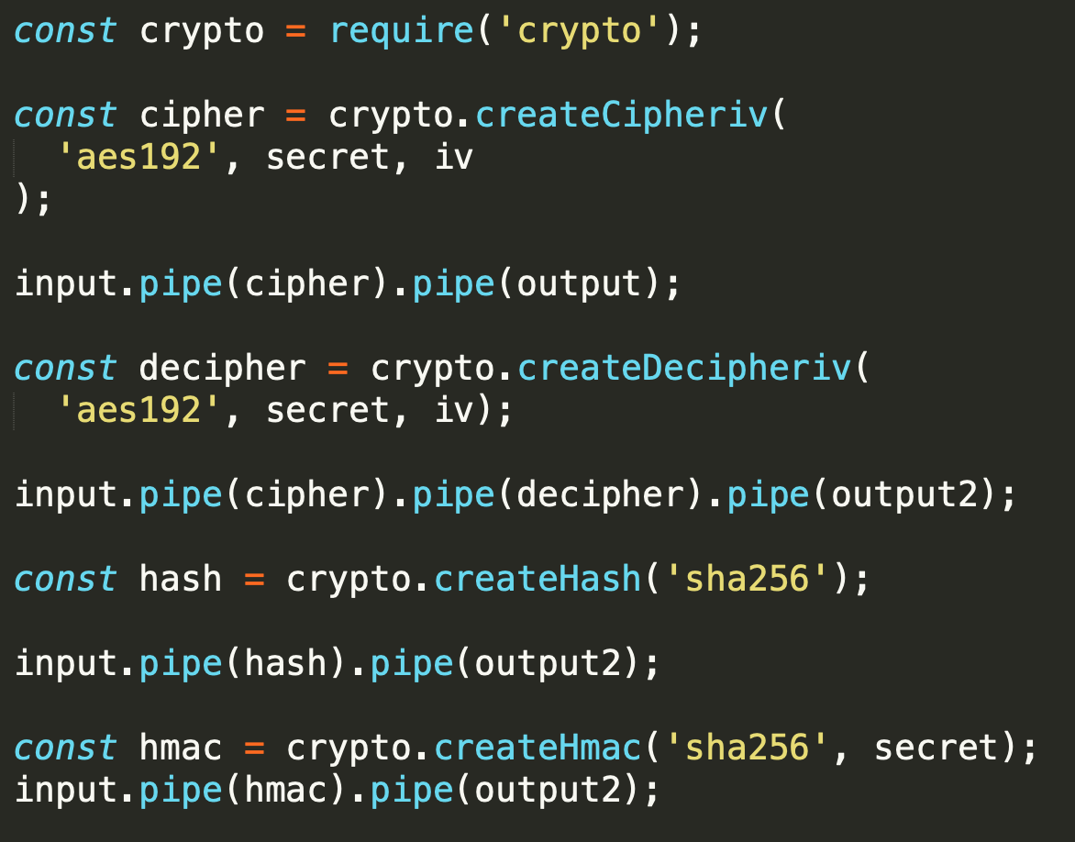
crypto streams
Transform streams for
encrypt
decrypt
hash
HMAC digests
uses OpenSSL implemented algorithms
https://nodejs.org/api/crypto.html
/samples/node-js-streams/crypto.js

Slide 22
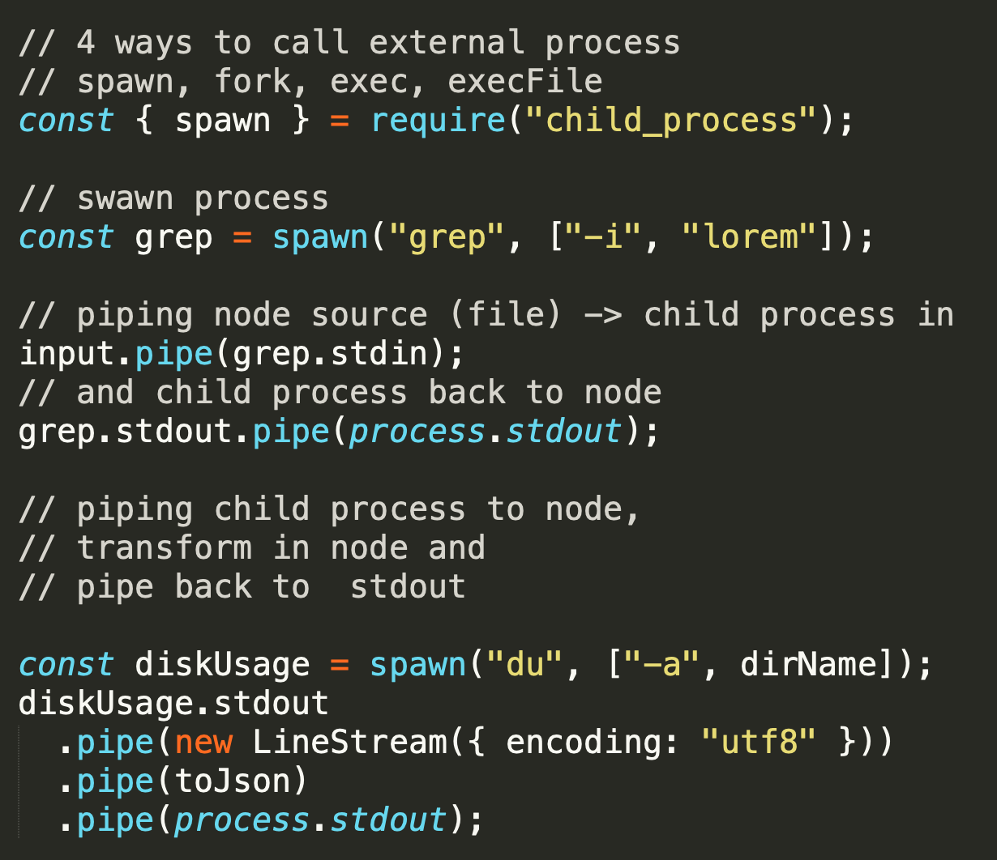
child process, stdin, stdout, stderr
The child_process module provides the ability to spawn child processes
we have access to stdin, stdout and stderr of these processes
we can combine external processes
with node streams
with other externla processes
out process std streams
https://nodejs.org/api/child_process.html
/samples/node-js-streams/child-process.js

Slide 23
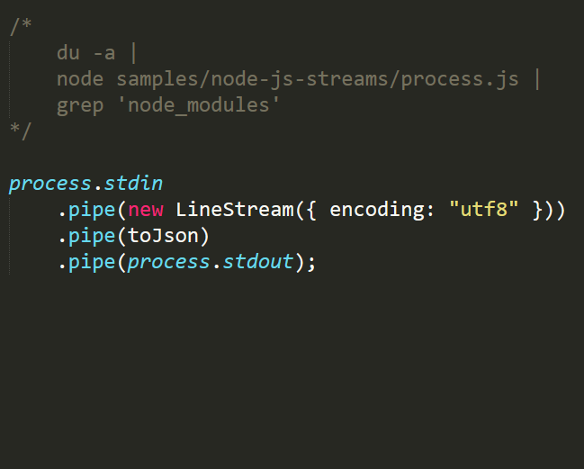
process , stdout, stdin, error, readline
The process object is a global that provides information about, and control over, the current Node.js process
process.stdin,
process.stdout,
process.stderr
Writes may be synchronous depending on what the stream is connected to and whether the system is Windows or POSIX
See also Readline and TTY
https://nodejs.org/api/process.html#process_a_note_on_process_i_o

Slide 24
Streams API
A)
B)
Use of the readable.pipe() method is recommended for most users as it has been implemented to provide the easiest way of consuming stream data
Streams are EventEmitters, developers that require more fine-grained control over the transfer and generation of data can use the EventEmitter and readable.pause()/readable.resume() APIs.
The Readable stream API evolved across multiple Node.js versions and provides multiple methods of consuming stream data. In general, developers should choose one of the methods of consuming data and should never use multiple methods to consume data from a single stream.

Slide 25
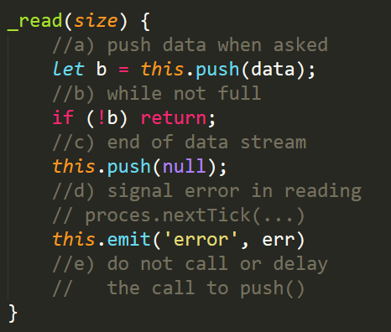
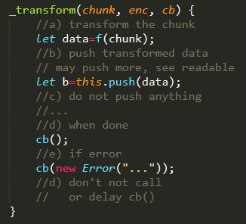
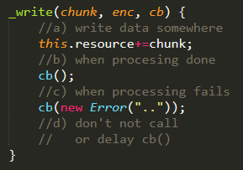
Implementing (with) Streams
Design solution as pipeline of stream, use existing streams or implement streams
pipe
pipe
Readable
Transform
Writable
readableBuffer
writableBuffer
readableBuffer
writableBuffer
extends
extends
extends
MyReadable
MyTransform
MyWritable
sync or async
sync or async
sync or async
Resource
service
Resource
Notes:
11-streams/samples/03-basic-contracts/_basic_contracts.js

Slide 26
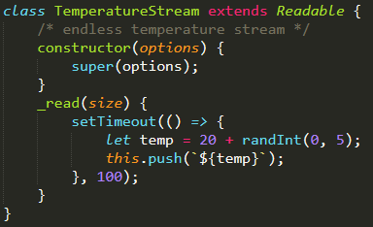
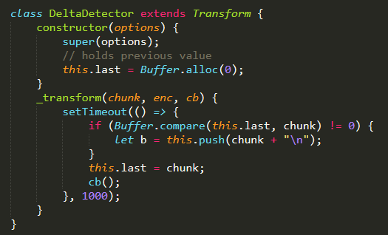
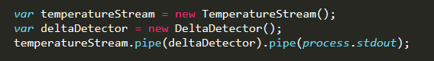
Implementing (with) Streams
Sample: Temperature Sensor
pipe
pipe
TemperatureStream
DeltaDetector
stdout
/samples/04-temp-sensor/TemperatureSensor.js

Slide 27
Implementing (with) Streams
Sample: Temperature Sensor
Patterns:
piping to multiple locations (built in node.js)
For other more complex patterns you need 3rd party libraries
pipe
pipe
TemperatureStream
DeltaDetector
stdout
OverHeatDetecor
stderr
/samples/04-temp-sensor/TemperatureSensor2.js

Slide 28
backpressure
speed of streams, backpressure and backpressure mechanism (flow control) in node.js streams

Slide 29
backpressure
Readable
Transform
Writable
readableBuffer
writableBuffer
readableBuffer
writableBuffer
sync or async
sync or async
sync or async
Resource
Resource
Resource
Streams may operate at different speed, we can have fast data producers and slow writers or slow transform in the middle. When that occurs, the consumer will begin to queue all the chunks of data for later consumption. The write queue will get longer and longer, and because of this more data must be kept in memory until the entire process has completed.
Backpressure will occur because the writer will not be able to keep up with the speed from the reader.
This is why a backpressure mechanism (flow control) is important. If a backpressure system was not present, the process would use up your system's memory, effectively slowing down other processes, and monopolizing a large part of your system until completion
https://nodejs.org/en/docs/guides/backpressuring-in-streams/

Slide 30
backpressure in node
flow control or backpressure mechanism in node.js is based on
from code point of view:
using pipe method
correct implementation of read, write and transform streams
from technical point of view
stream events (data, readable,…) and methods (read, write,…)
stream modes
push-based a.k.a. flowing mode
pull-based a.k.a. paused mode
internal implementation of pipe method setting all this mechanism between streams

Slide 31
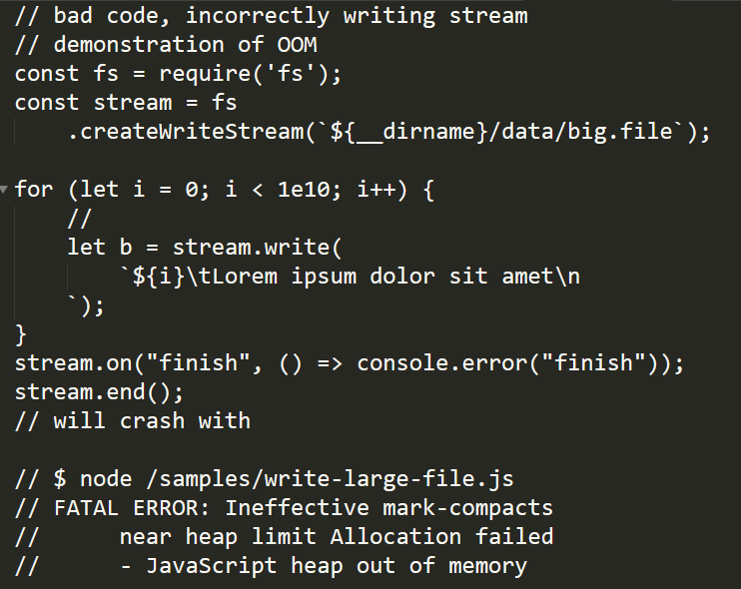
Problem Demonstration
using streams without backpressure mechanism
for example directly and incorrectly writing to stream without pipe
While a stream is not draining, calls to write() will buffer chunk, and return false. Once all currently buffered chunks are drained (accepted for delivery by the operating system), the 'drain' event will be emitted. It is recommended that once write() returns false, no more chunks be written until the 'drain' event is emitted. While calling write() on a stream that is not draining is allowed, Node.js will buffer all written chunks until maximum memory usage occurs, at which point it will abort unconditionally…….
…..Since TCP sockets may never drain if the remote peer does not read the data, writing a socket that is not draining may lead to a remotely exploitable vulnerability.
prvych cca 400 volani este stihalo a vracalo true,
nasledne uz prestali stihat a preplnil sa buffer
vo Writable.
11-streams/samples/05-backpresure/write-large-file.js

Slide 32
Implementing Streams

Slide 33
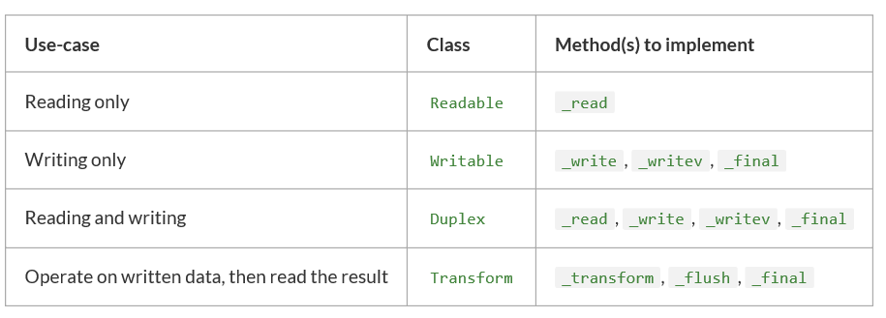
Implementing Streams
The new stream class must then implement one or more specific methods, depending on the type of stream being created, as detailed in the chart below:
In the method implementations - correctly implementing flow control (backpressure) values and callbacks

Slide 34
Implementing Readable
Kedy kódovať vlastný readable
keď potrebujete niečo čo node nemá
ale node má streamy na net,http,fs, tcp, process,...
možno generátory, konverzie datových typov na streamy kôli existujúcim pipeline,
skrytie pull, pull, pull za abstrakciu streamu....
Stream API k iným vašim biznis komponentom
GoldStock.priceStream
....
Kedy nekódovať vlastný readable
nerobte readable ak viete spraviť standardReadable.pipe(myTransform)

Slide 35
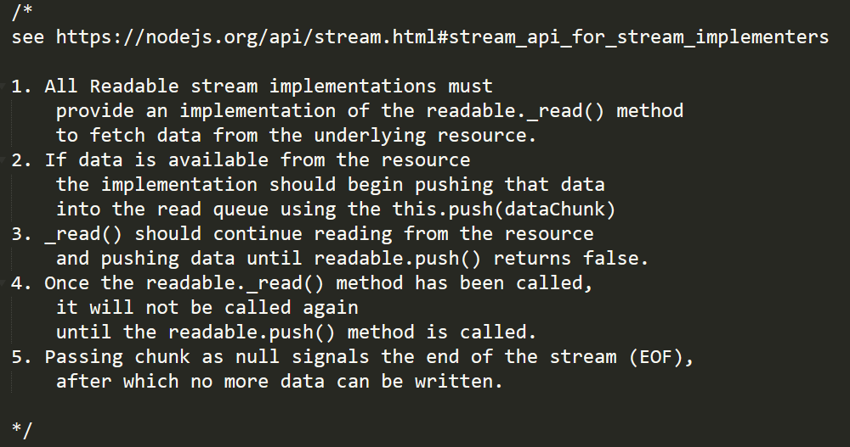
Readable Contract
MUST implement:
_read(chunk, encoding, callback)

Slide 36
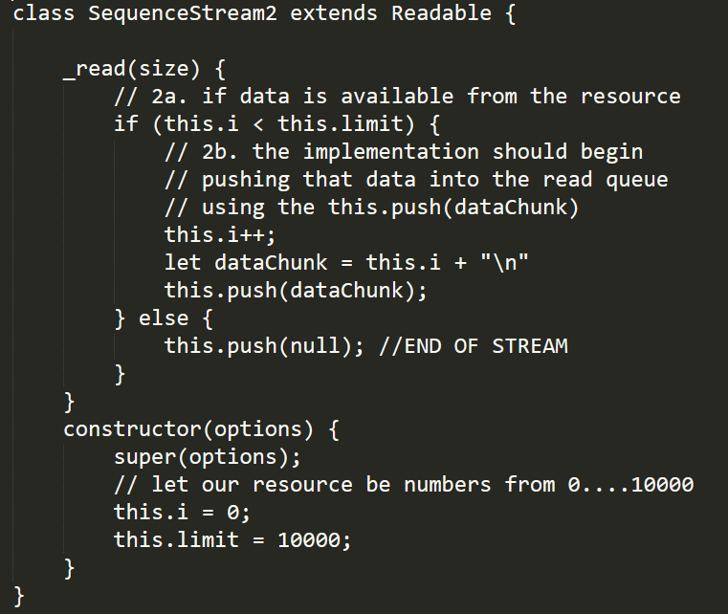
2. and 5. Implementing Readable
2) nech je resource sekvencia čísiel
2a) ak niekto zavolá read, _read() spraví push ak ešte nedošli čísla
5) ak sme už vyčerpali čísla, signalizujeme EOF, pushnutím null
2a.
5.
2.

Slide 37
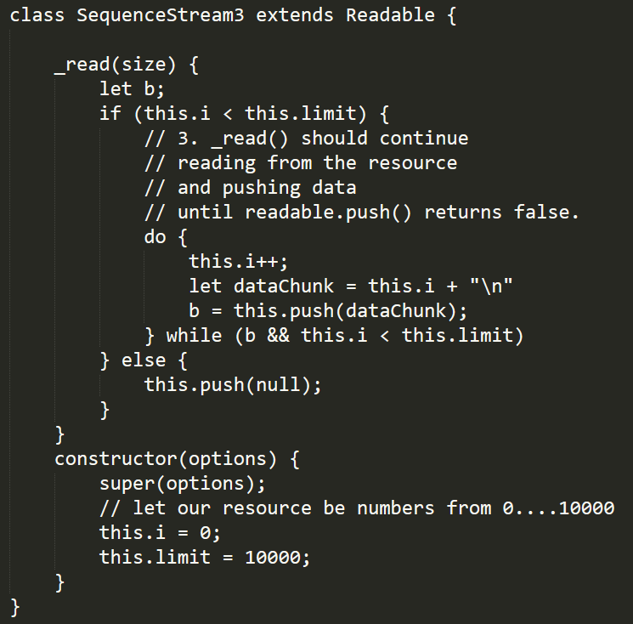
3. Implementing Readable
Doplnenie predchádzajúcej implementácie:
bod 3 vraví, že pri jednom zavolaní _read máme vrátiť aj viac čísiel, teda zavolať push kým nám return z push neoznámi, že je plný buffer
3.

Slide 38
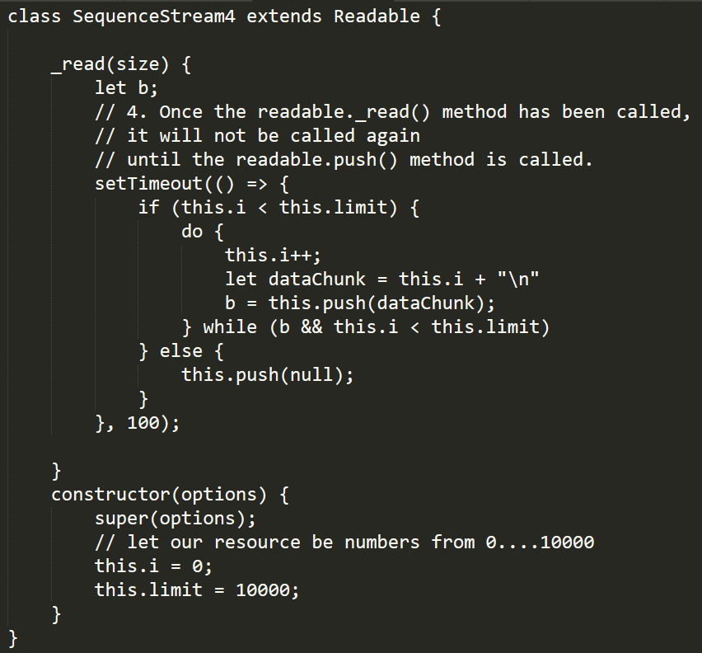
4. Implementing Readable
Async: Bod 4 vraví o tom, že _read nemusí spraviť push okamžite, ale kľudne aj neskôr (ak je resource asynchrónny), a že sa s tým nemusíme trápiť lebo parent implemenácia Readable zabezpečí, že našu _read metódu nik dovtedy nezavolá. Toto dáva priestor na jednoduchú implementáciu asynchrónnych readable
Príklad používa jednoduchý timer okolo celého bloku..
4

Slide 39
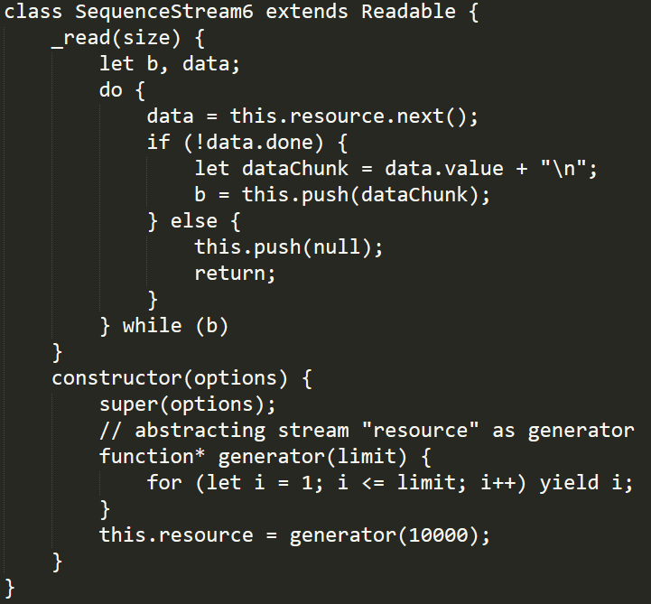
Resource - Implementing Readable
Prezentovaný kód sa dá podstatne zjednodušiť a bude oveľa semantickejší ak použijeme generátor ako abstrakciu zdroja dát

Slide 40
4. Implementing Readable
Popravde Sync Readable je big problem. Ak spravite _read ako synchronny, teda zavolate this.push teraz, a nie “later”, je uplne jedno ze mate korektne riesene “b”. Ak spravite sync.pipe(dest) bude cele citanie z stream az dokonca (aj na viac buffrov) vykonane v jednej funkcii (a nik si medzitym “netickne”).

Slide 41
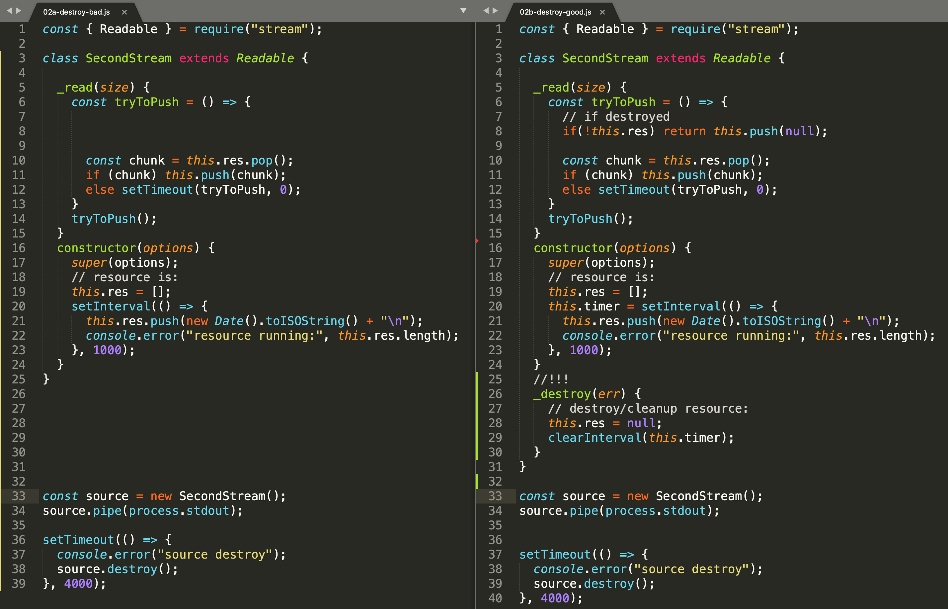




6. Implementing Readable - _destroy
_destroy – ak mate resource, ktorý potrebuje „cleanup“
Notes:
Doksy uvadzaju aj my sme si vraveli,
ze pre readable vam staci _read implementnut, ale nestaci, bohizial.....

Slide 42
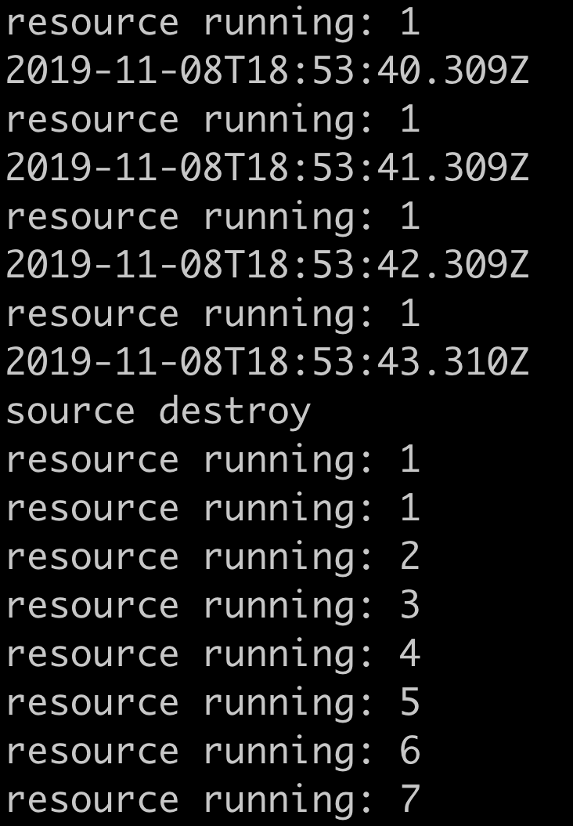
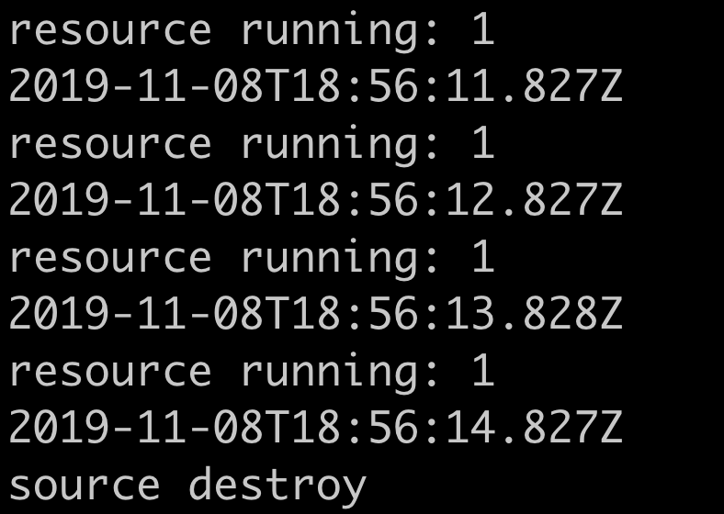

6. Implementing Readable - _destroy
_read (1,2,3,4,5)
_destroy – ak mate resource ktory potrebuje „cleanup“ a nespravite ho tak: budete dalej cerpat resources (procesor, memory atd...)

Slide 43
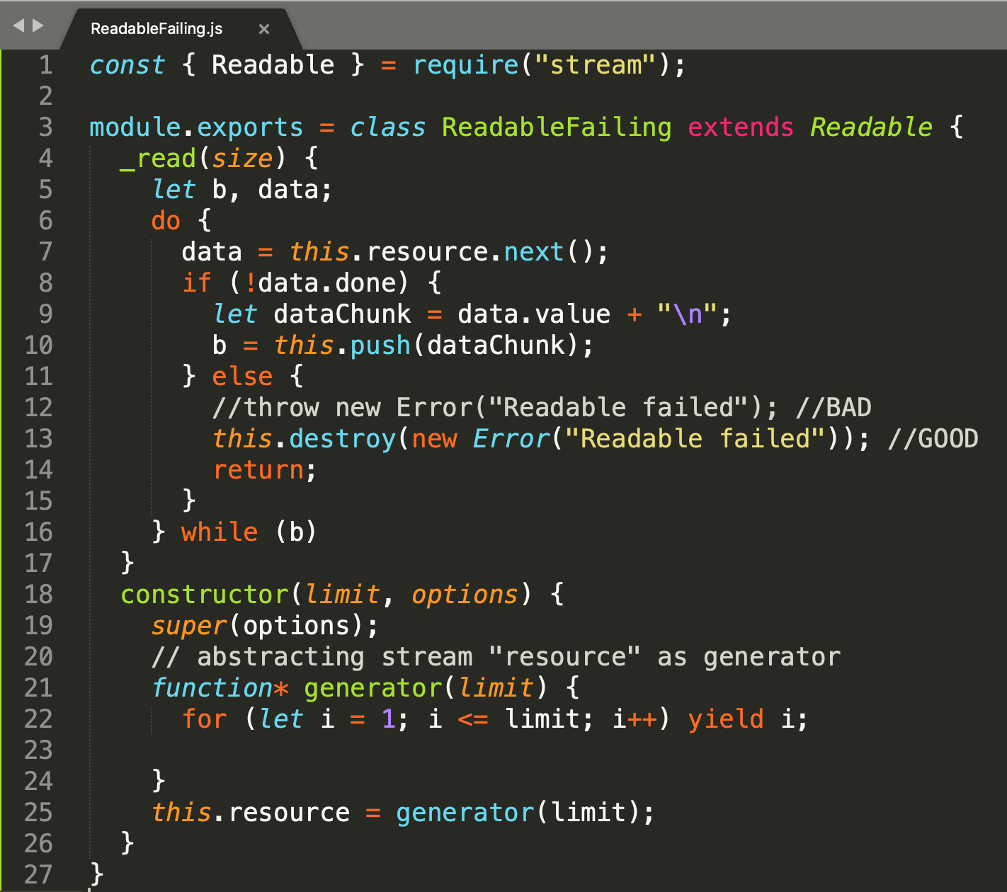


7. Implementing Readable - errors
Errors occurring during processing of the readable._read() must be propagated through the readable.destroy(err) method.
Throwing an Error from within readable._read() or manually emitting an 'error' event results in undefined behavior.

Slide 44
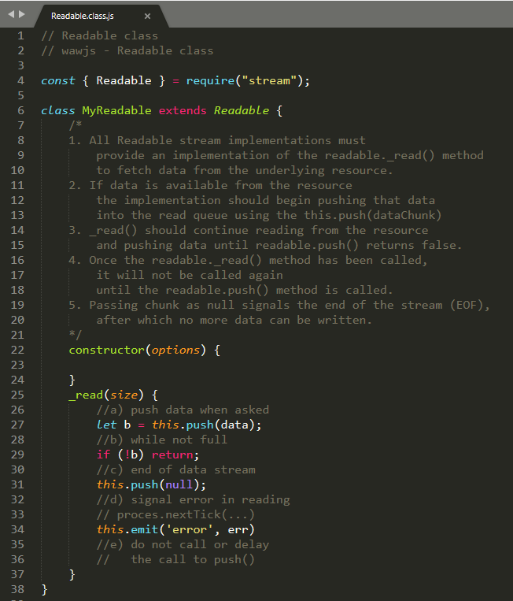
wawjs-snippets
v projekte wawjs- snippets nájdete kostru readable s podstatnými záchytnými bodmi
https://github.com/ainthek/wawjs-snippets
https://github.com/timzatko/wawjs-snippets
https://github.com/trogper/wawjs-snippets/tree/atom

Slide 45
Implementing Writable
Kedy kódovať vlastný writable
keď potrebujete zapisovať na niečo čo node nemá
ale node má streamy na net,http,fs, tcp, process,...
konverzie streamov na finálnu stuktúru (array, json,…)
Stream API k iným vašim biznis komponentom
someone | GoldStock.priceStream
....
Kedy nekódovať vlastný writable
ak viete použiť transform.pipe(standardWritable)
konverzie streamov na finálnu stuktúru (array, json)
mozete pouzit on data() alebo read() a zozbierat si vysledky

Slide 46
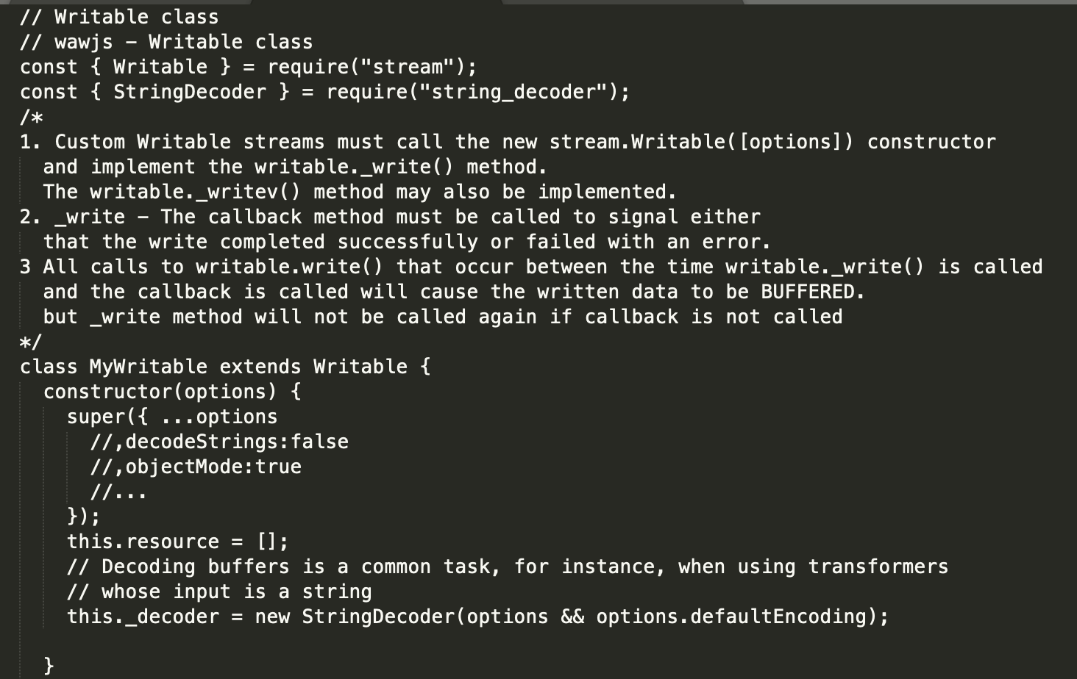
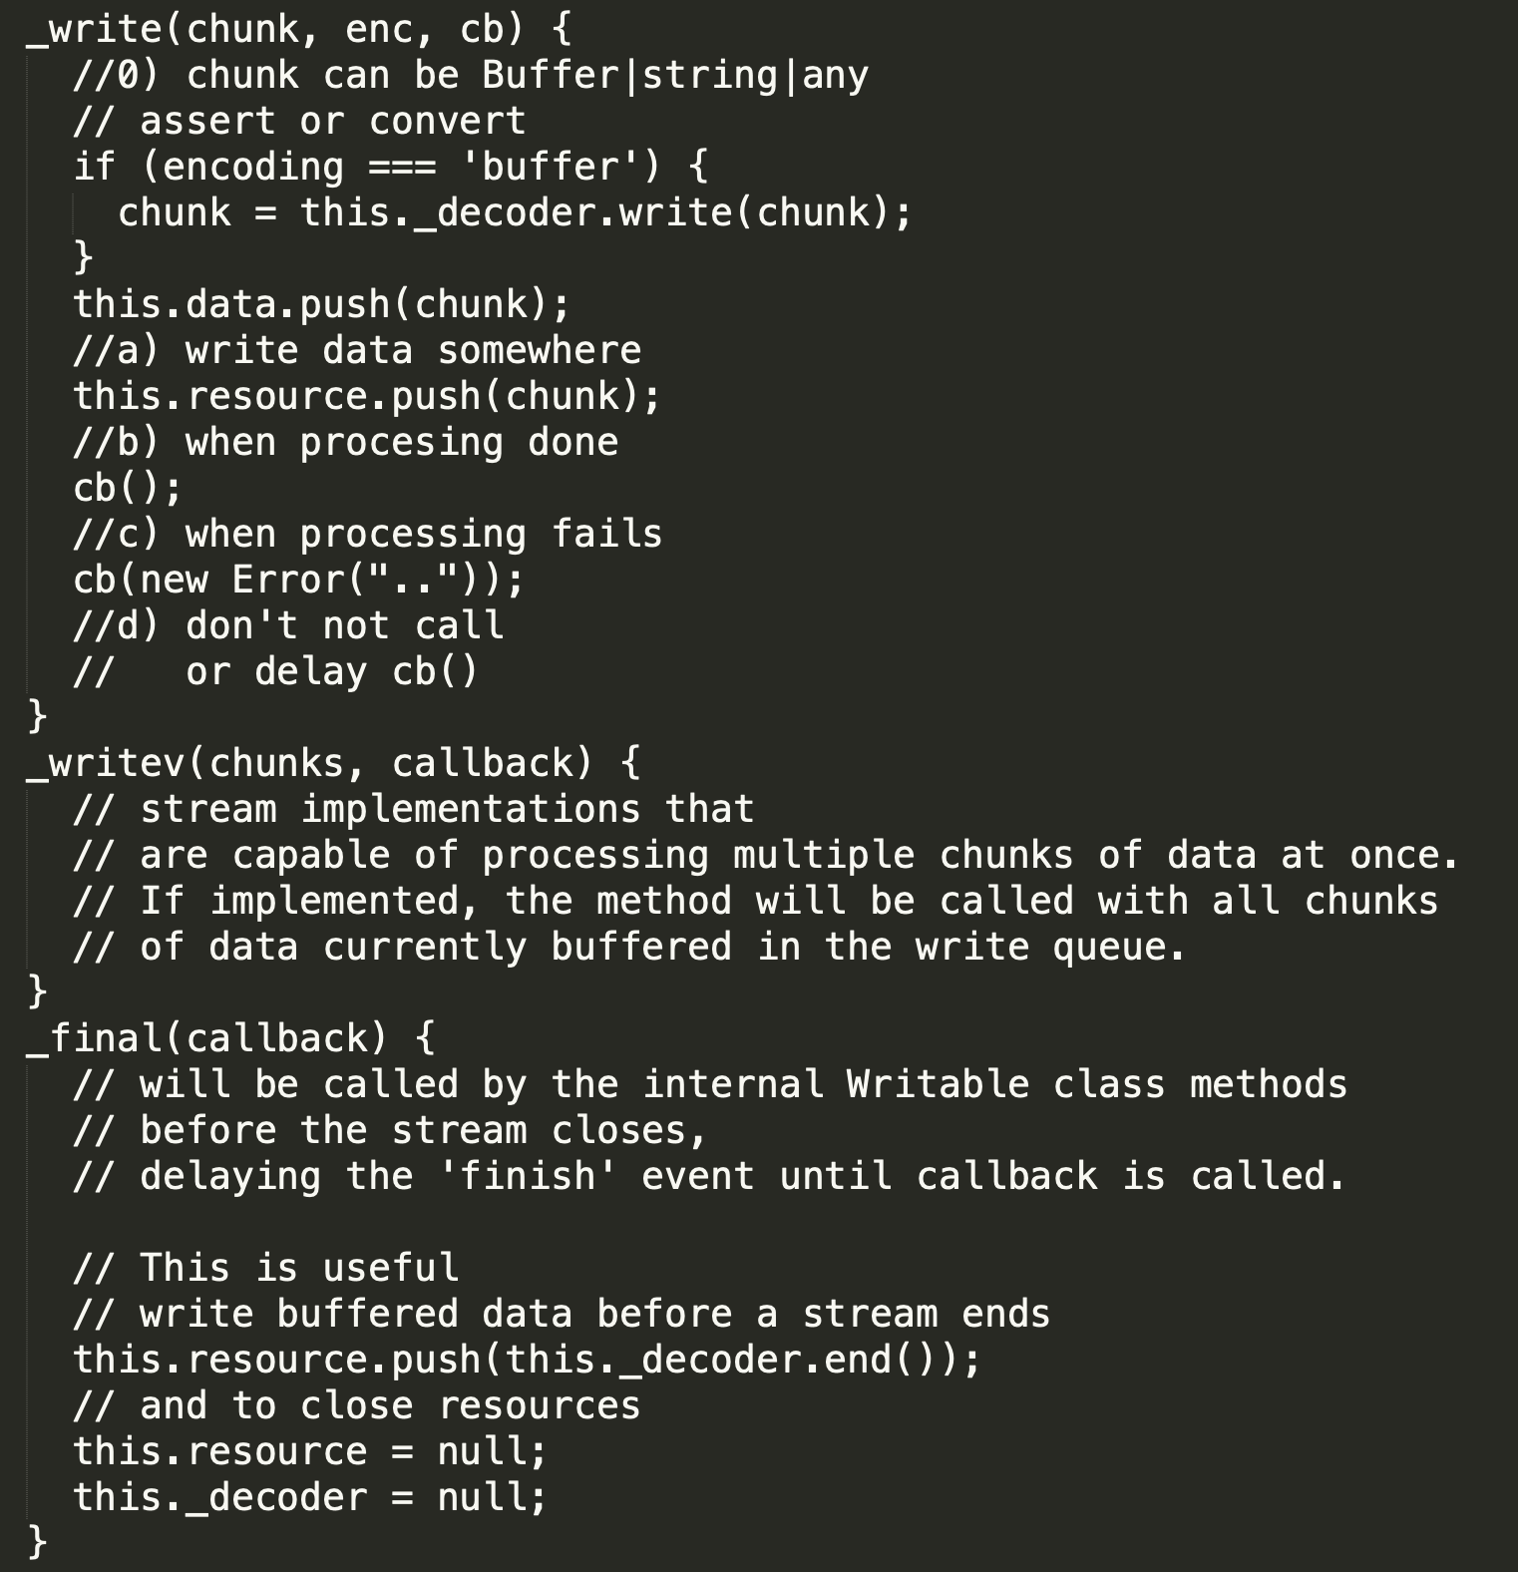
Writable Contract
MUST implement:
constructor
_write
MAY need also:
_final
_writev
Other Topics:
decoding strings from buffers

Slide 47
Implementing Writable
Samples:
/samples/07-implementing-writable
00-contract.js
jsonWriter.js
objectWriter.js
Domáca úloha:
pozrieť si ich a skúsiť si k nim napísať reálne mocha testy, nájsť potenciálne bugy
Pohľadať na githube projekty implementujúce nejaký custom writable
Snippets:
https://github.com/ainthek/wawjs-snippets

Slide 48
Implementing Trasform
Tento typ streamov budete kódovať sami asi najčastejšie
Kedy kódovať vlastný Transform
vždy, ak nenájdete iný dobrý na npm
ak potrebujete zo streamu do streamu niečo konvertovať
Obaliť nestreamovú vunkcionalitu do streamovej (napr. máte libku na detekciu viet, a chcete z nej transform stream)
Kedy nekódovať vlastný Transform
ak už nepokračujete v streame a výsledok už nie je stream ale jednorázová finálna štruktúra
ale aj na toto existujú výnimky (napr. crypto streamy)

Slide 49
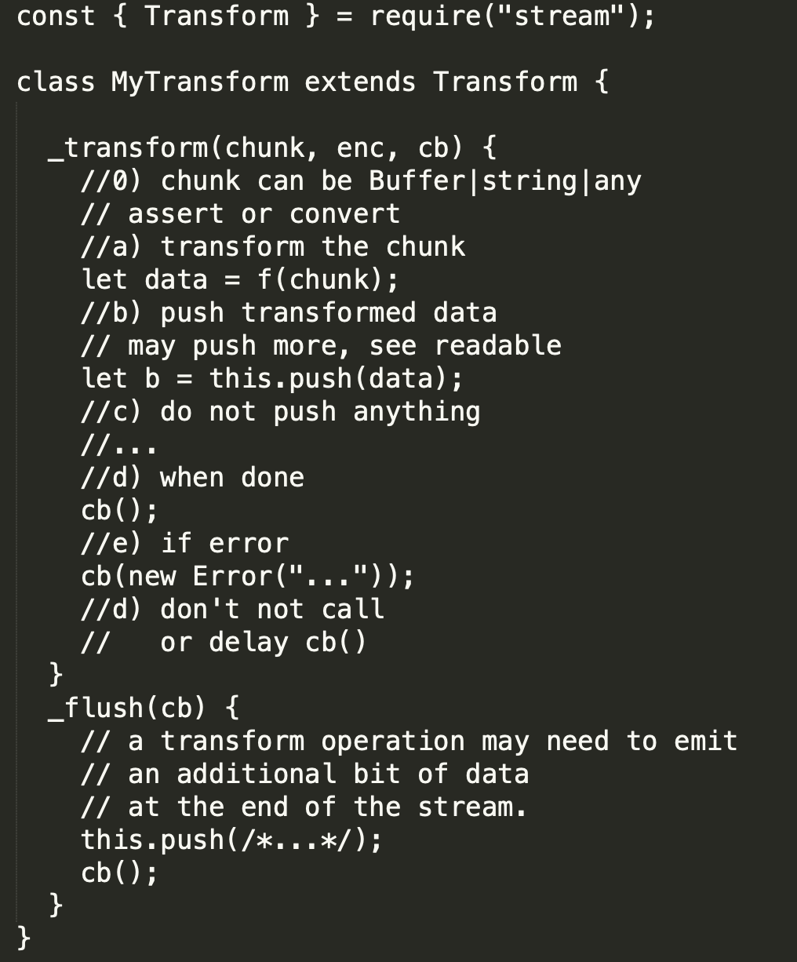
Transform Contract
MUST implement:
_transform
MAY need also: _flush
Základ:
push + cb

Slide 50
Transform Contract
MUST implement:
_transform
MAY need also: _flush
Transform je readable aj writable takže všetky komplikácie s nimi, sa týkajú aj Transformu
Napr: data written to the stream can cause the Writable side of the stream to become paused if the output on the Readable side is not consumed
https://nodejs.org/api/stream.html#stream_implementing_a_transform_stream

Slide 51
Implementing Trasform
Samples:
Na cviku je kompletný walkthrough z implementáciou transformu (BOM add)
10-cvicenie/uloha02/bom-transform-and-buffer-walk.pptx
src a test foldre
Iné sample:
/samples/04-temp-sensor/TemperatureSensor.js#DeltaDetector
Nájdete aj ďalšie roztrúsené v iných samploch z prednášok...
git grep Transform
Transform nad
Binárnymi streamami
Textovými streamami
Objektovými streamami

Slide 52
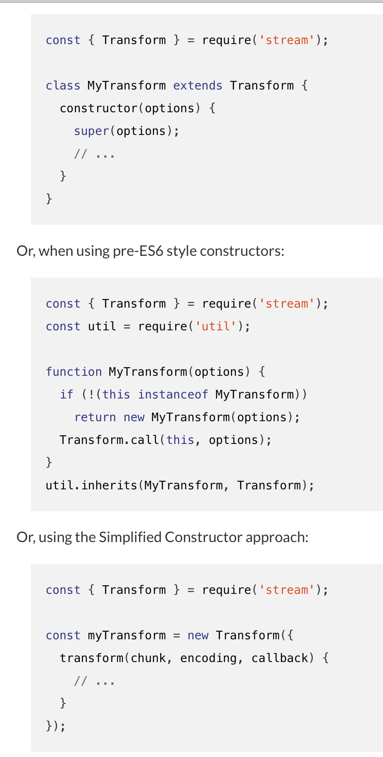
Stream Implementation Options
inherit class
util.inherit
simplified constructor
3rd party existing modules
3rd party simplifications..... through2,...
...
...
RxJs ....
https://nodejs.org/api/stream.html#stream_implementing_a_transform_stream

Slide 53
Object Streams

Slide 54
Streams data - objectMode
Streams operate with one of:
Buffer – processing binary data
String - processing decoded strings
Object – processing business objects
stream.objectMode=true;
All streams created by Node.js APIs operate exclusively on strings and Buffer (or Uint8Array) objects.
It is possible, however, for stream implementations to work with other types of JavaScript values (with the exception of null, which serves a special purpose within streams).
Such streams are considered to operate in "object mode".
Stream instances are switched into object mode using the objectMode option when the stream is created. Attempting to switch an existing stream into object mode is not safe.

Slide 55
Object Streams
Usage:
convert string streams to objects streams for easier manipulations
build whole applications based on business objects with input output streams and connect them using pipelines of object stream transforms
Those types of applications dealing with streams of data: sensors connected over TCP/HTTP protocol
Basic idea for other paradigms (data-flows, RP)

Slide 56
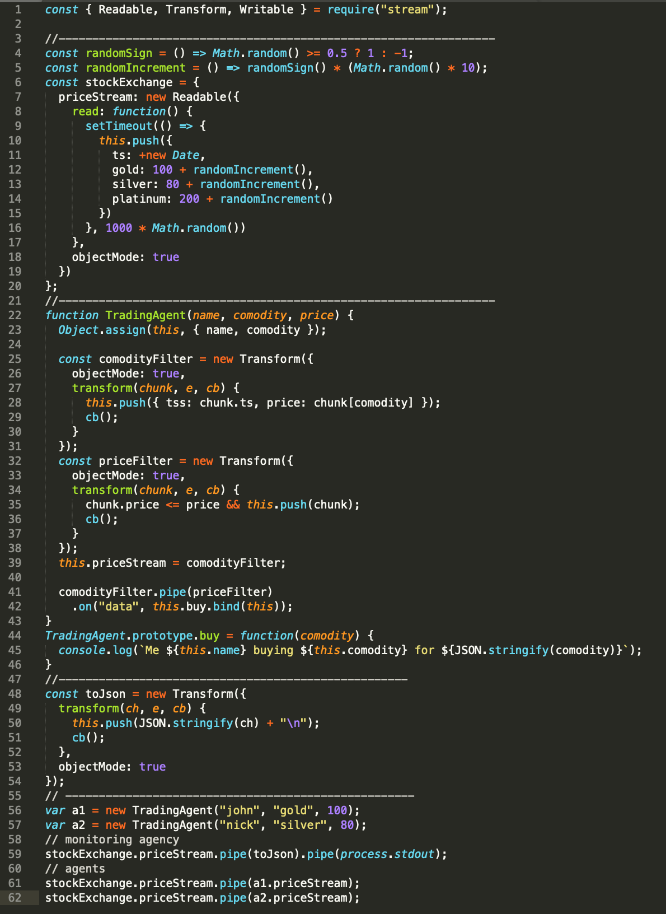
Sample
StockExchange
priceStream
priceStream
priceStream
transform
transform
filter
filter
buy
buy
TradingAgent
TradingAgent
./samples/09-object-streams/stockExchange.js

Slide 57
Another Sample
sensor 1
sensor 2
sensor 3
pipe
ControlUnit.agregatorStream
transform
filter
transform
filter
filter
device1
device1
admin

Slide 58
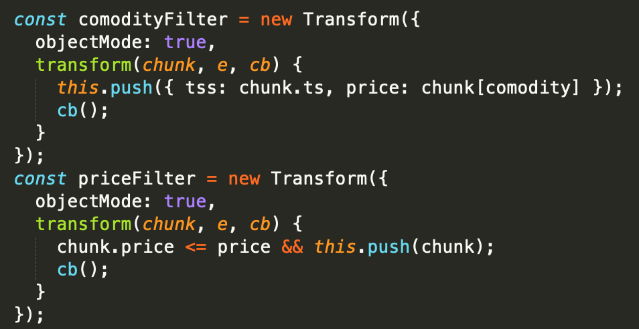
Simplifying implementation of object transform streams
Known from FP:
filter, map,...
How about simplifying Object stream Transforms ?
./samples/09-object-streams/04-simplify.js
Notes:
Objektovy transform je easy, najme ak je pass through a nemusi buffrovat tak je to jeden push a jeden cb()

Slide 59
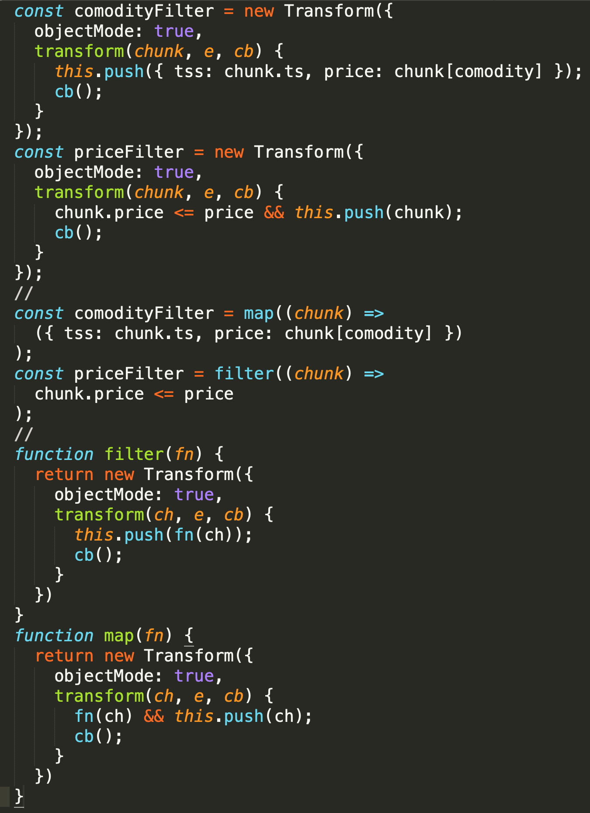
Simplifying implementation of object transform streams
even simplified constructor is still a lot of boilerplate code
synchronous version of transform is easy
what about async version, what if transform needs to call service or do other async task ? (see writable contract # 3)
many 3rd party libs already implement this simplification
…. RxJs and other reactive libraries
./samples/09-object-streams/04-simplify.js

Slide 60
Error Handling With Stream
RECAP: pozri paradigmy a vzory
on(„error“)
Ak mam viacej streamov v pipe().pipe().pipe() a niekde nastane chyba, v akom stave ostanú ostatné streamy ?
ich fyzické resource (FileHandle)
Ich interné resources (memory štruktúry, buffre,...)
Ich stav (sú použiteľné ďalej)
Prečo je to dôležité:
Pipe do viac streamov...čo ak jeden padne, čo bude z druhým
Bezpečnosť – incorrect/malicious stream writers, readers
Handle Leaks (pozri 2018-javascript/prednasky/11-deployment-maintenance/deployment-maintenance-monitoring.pptx)

Slide 61
Error Handling With Stream
Celá téma je o tom, čo sa stane ak niektorý zo streamov zlyhá
Ale pozor môžeme mať rôzne scenáre pospájania streamov
A celé ešte kombinované o pipe vs. pipeline

Slide 62
Error Handling With Stream
pipe
pipe
pipe
r
w
r
w
r
w
By default, stream.end() is called on the destination Writable stream when the source Readable stream emits 'end
if the Readable stream emits an error during processing, the Writable destination is not closed automatically
Writable stream is not closed when the 'error' event is emitted unless the autoDestroy option was set to true when creating the stream.
unpiped
not unpiped
If a Readable stream pipes into a Writable stream when Writable emits an error, the Readable stream will be unpiped
closed
Not closed automatically
Readable stream not closed

Slide 63




Pipe and error handling
Lets have 3 streams
Transform fails and corectly signals error using callback
Let‘s pipe them
Trouble – input is not closed
Order of events show that pipe did not close the input

Slide 64




pipeline() for rescue
Lets have 3 streams
Transform fails and corectly signals error using callback
Let‘s connect them using pipeline
OK – input FH is closed
Order of events show that pipeline guaranteed correct cleanup of piped resources

Slide 65
pipeline() and finished() for rescue
stream.pipeline(...streams, callback)#
Added in: v10.0.0
A module method to pipe between streams forwarding errors and properly cleaning up and provide a callback when the pipeline is complete.
stream.finished(stream[, options], callback)#
Added in: v10.0.0
A function to get notified when a stream is no longer readable, writable or has experienced an error or a premature close event.
https://nodejs.org/api/stream.html#stream_stream_pipeline_streams_callback

Slide 66
pipeline() a finished()
https://github.com/mafintosh/pump
https://github.com/mafintosh/end-of-stream
https://github.com/mafintosh/pumpify
Pre staršie verzie nodu

Slide 67
Error Handling With Stream
pipeline (
r
t
t
w
)
pipeline (
r
t
t
w
)
pipeline (
r
t
t
w
)
Takéto prípady sa riešia ľahko z pipeline
U zložitejších už musíte vedieť ako to funguje a čo chcete dosiahnuť
Aby vám to „nepopadalo celé“ ak netreba
Aby keď niečo popadá, neostalo niečo leakovať
r
t
w
r
w

Slide 68

_aux

Slide 69
_aux
pipe
pipe
r
w
r
w
pipe (end:false)
pipe (end:false)
r
w
r
w
pipe
pipe
r
t
w
pipe
pipe
r
t
w
pipe
pipe
r
t
t
w
r
w
r
w
w
w
r
t
w
r
w

